Slide 1

KQL Café: Brewing Queries with MSAL Authentication
A step-by-step guide to creating an interactive KQL interface

Slide 2

Overview
Let’s build a web app that allows users to authenticate with Azure, select a workspace, preview KQL (Kusto Query Language) queries from a GitHub repository, and run them in Microsoft Sentinel.
Here’s a step-by-step breakdown of its structure and how you could build it from scratch:

Slide 3
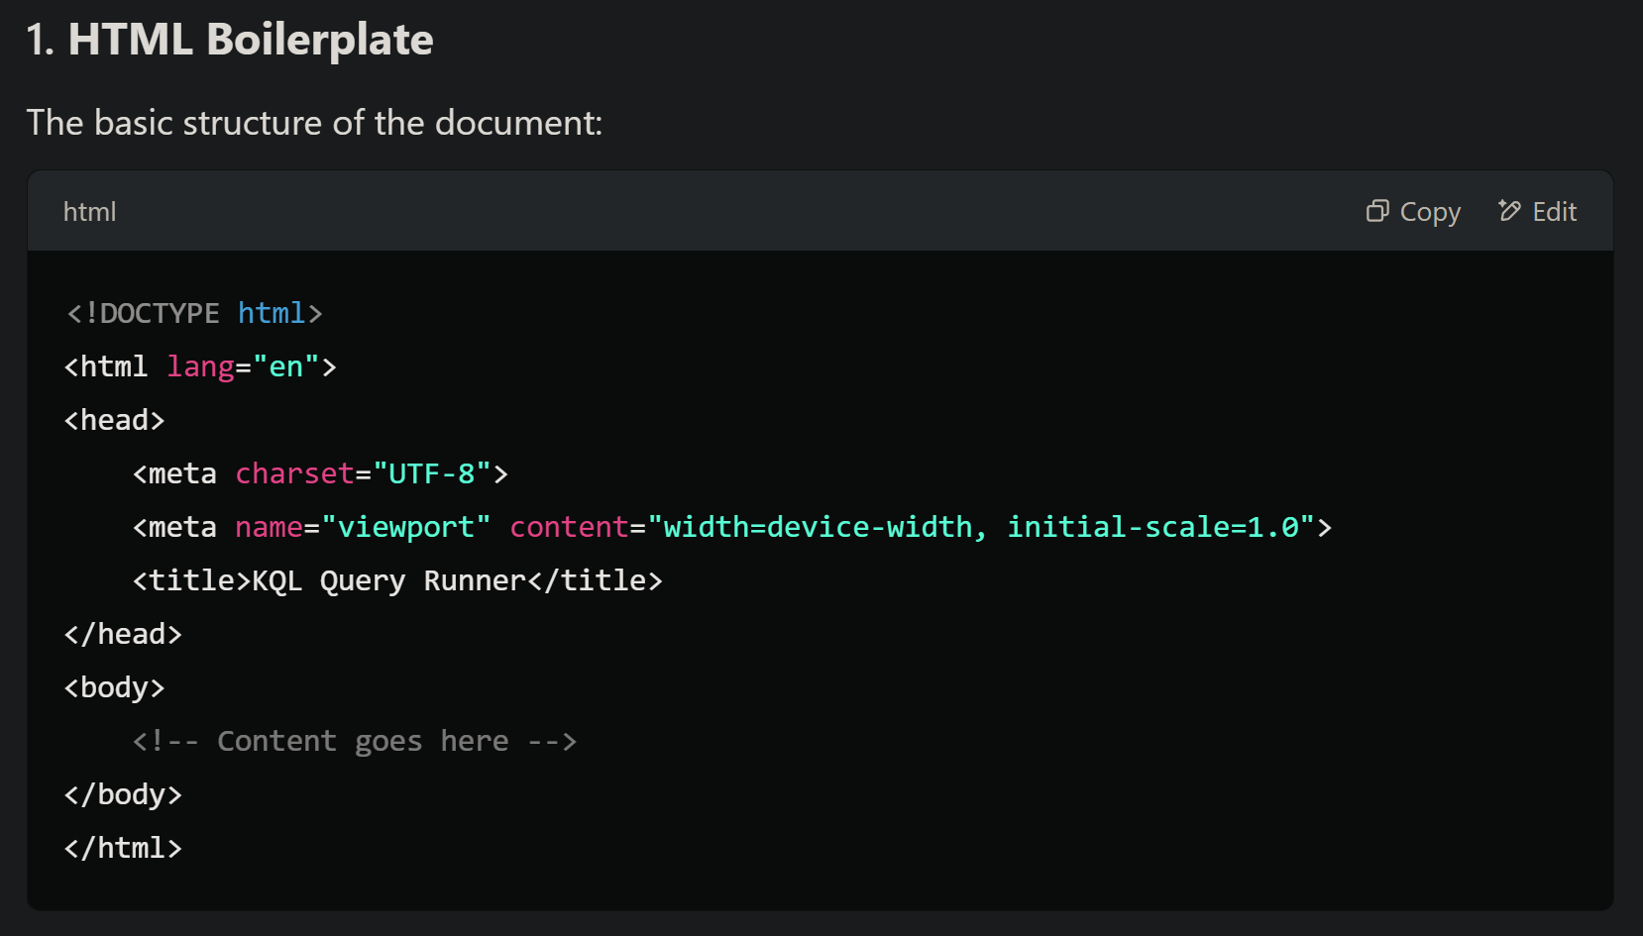

Slide 4
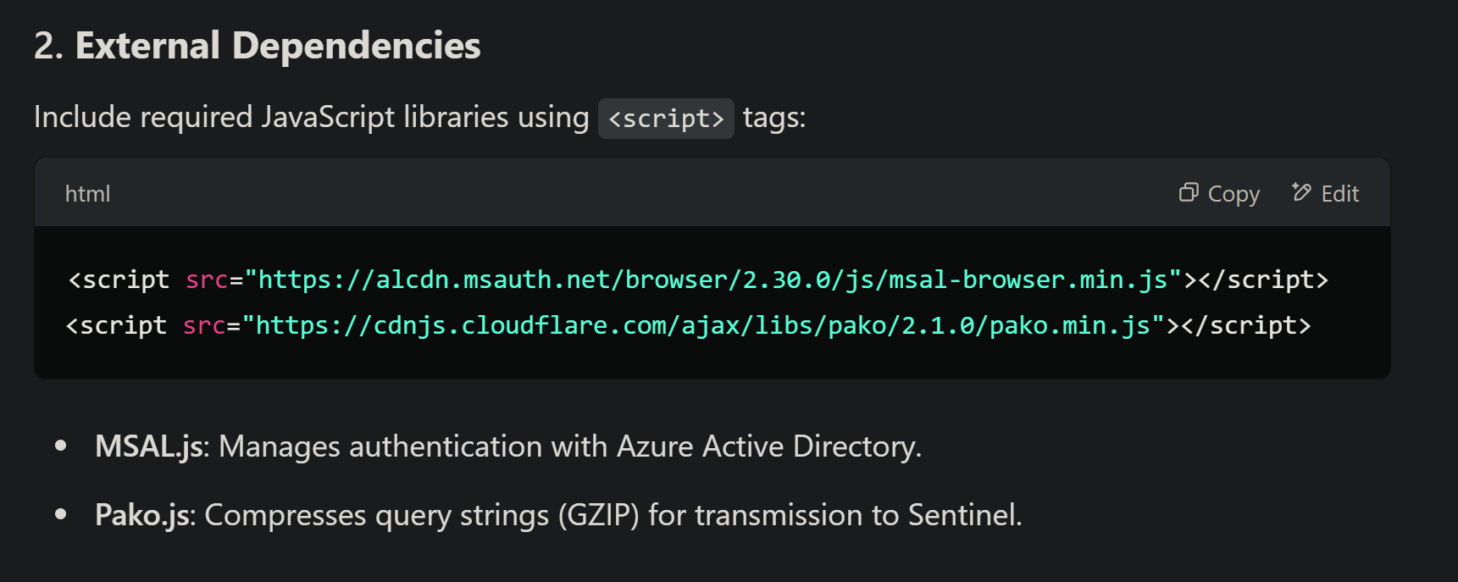
External Dependencies
MSAL
Pako

Slide 5
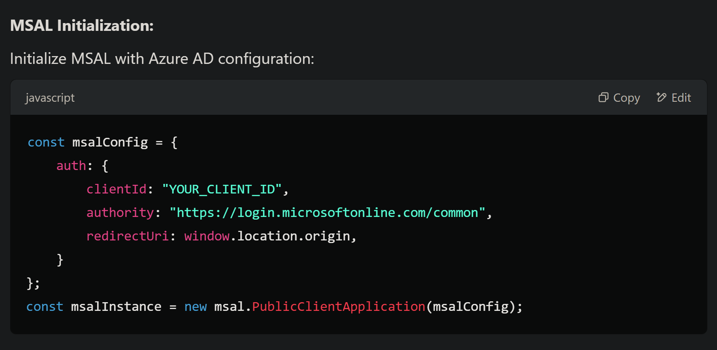
Microsoft Authentication Library

Slide 6
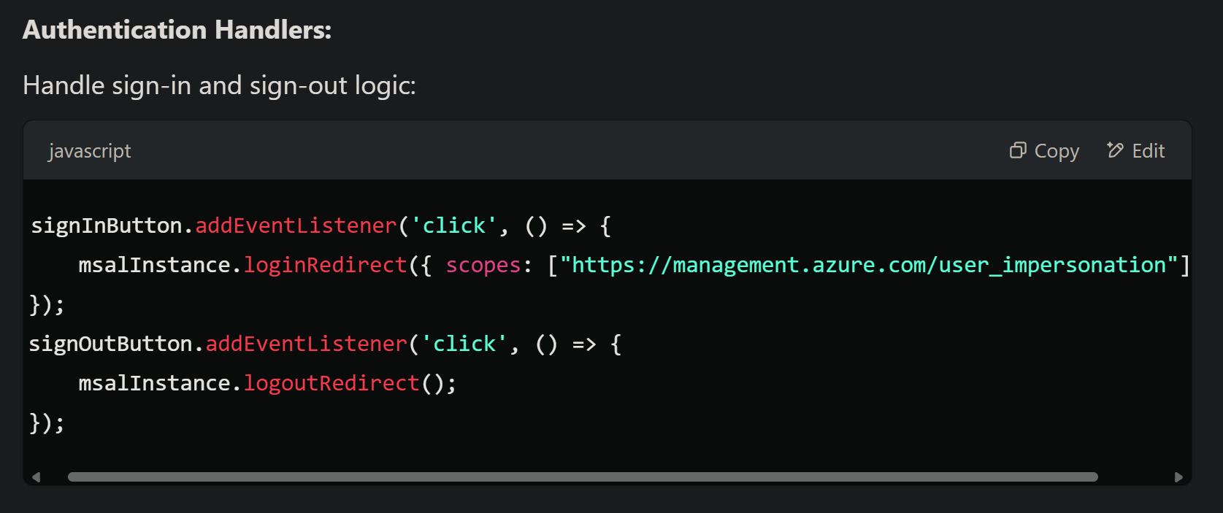
Authentication Handler
EntraID Registered App
User Impersonation

Slide 7
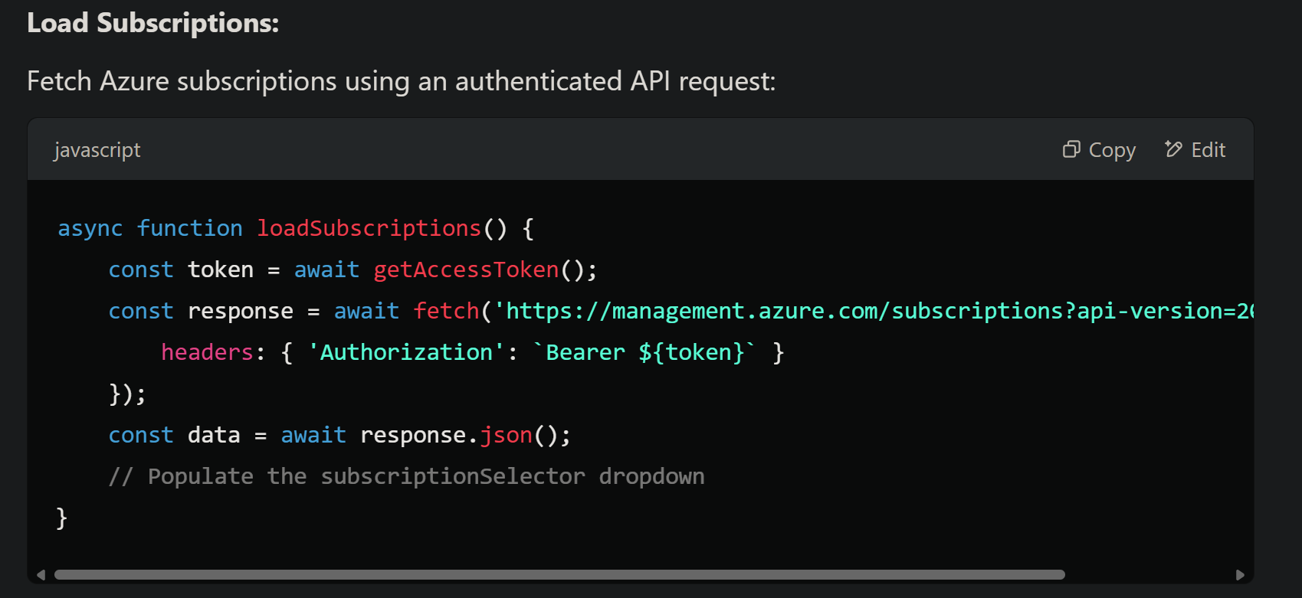
Pass the Token
User Impersonation

Slide 8
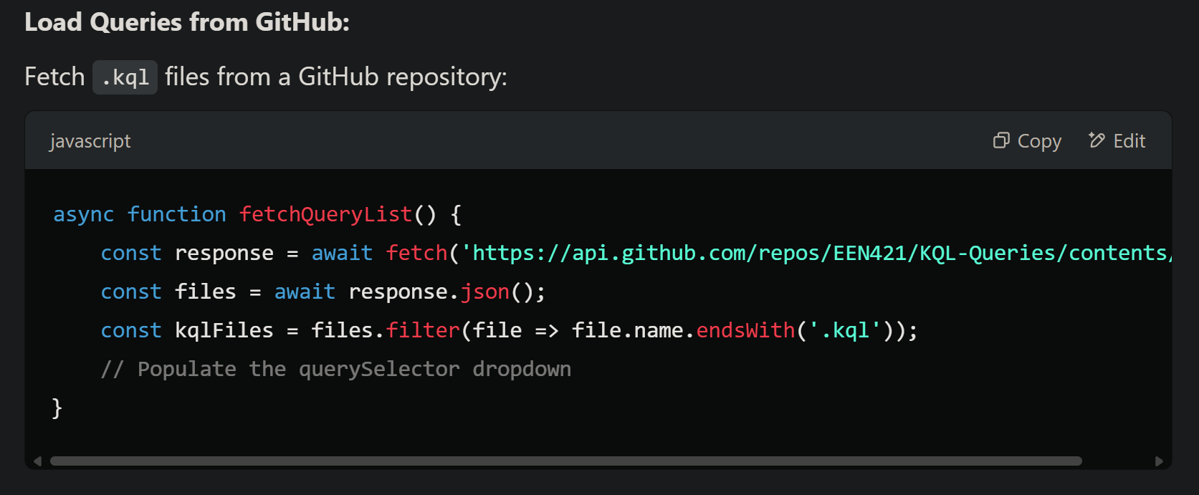
Populate from your Github
Github API

Slide 9
Populate from your Github
// Compress and encode the query
const encodedQuery = await compressAndEncodeQuery(content);
// Construct URL using the new format
const url = "https://portal.azure.com/#blade/" +
`Microsoft_Azure_Monitoring_Logs/LogsBlade/resourceId/%2Fsubscriptions%2F${s
ubscriptionId}%2FresourceGroups%2F${resourceGroup}%2Fproviders%2Fmicrosoft.opera
tionalinsights%2Fworkspaces%2F${workspaceName}/source/LogsBlade.AnalyticsShareLi
nkToQuery/query/${encodedQuery}/isQueryBase64Compressed/true`;
Github API

Slide 10
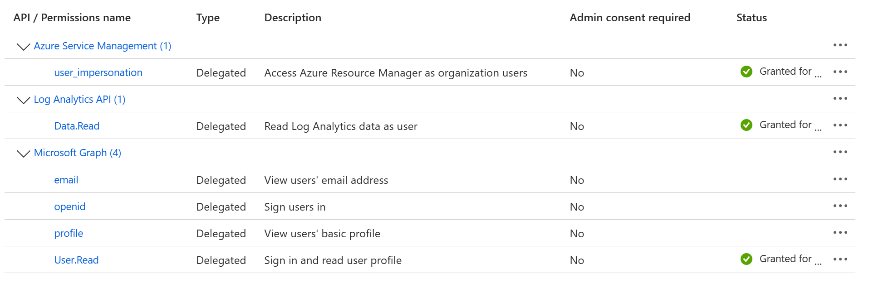
EntraID Registered App
Configured Permissions

Slide 11
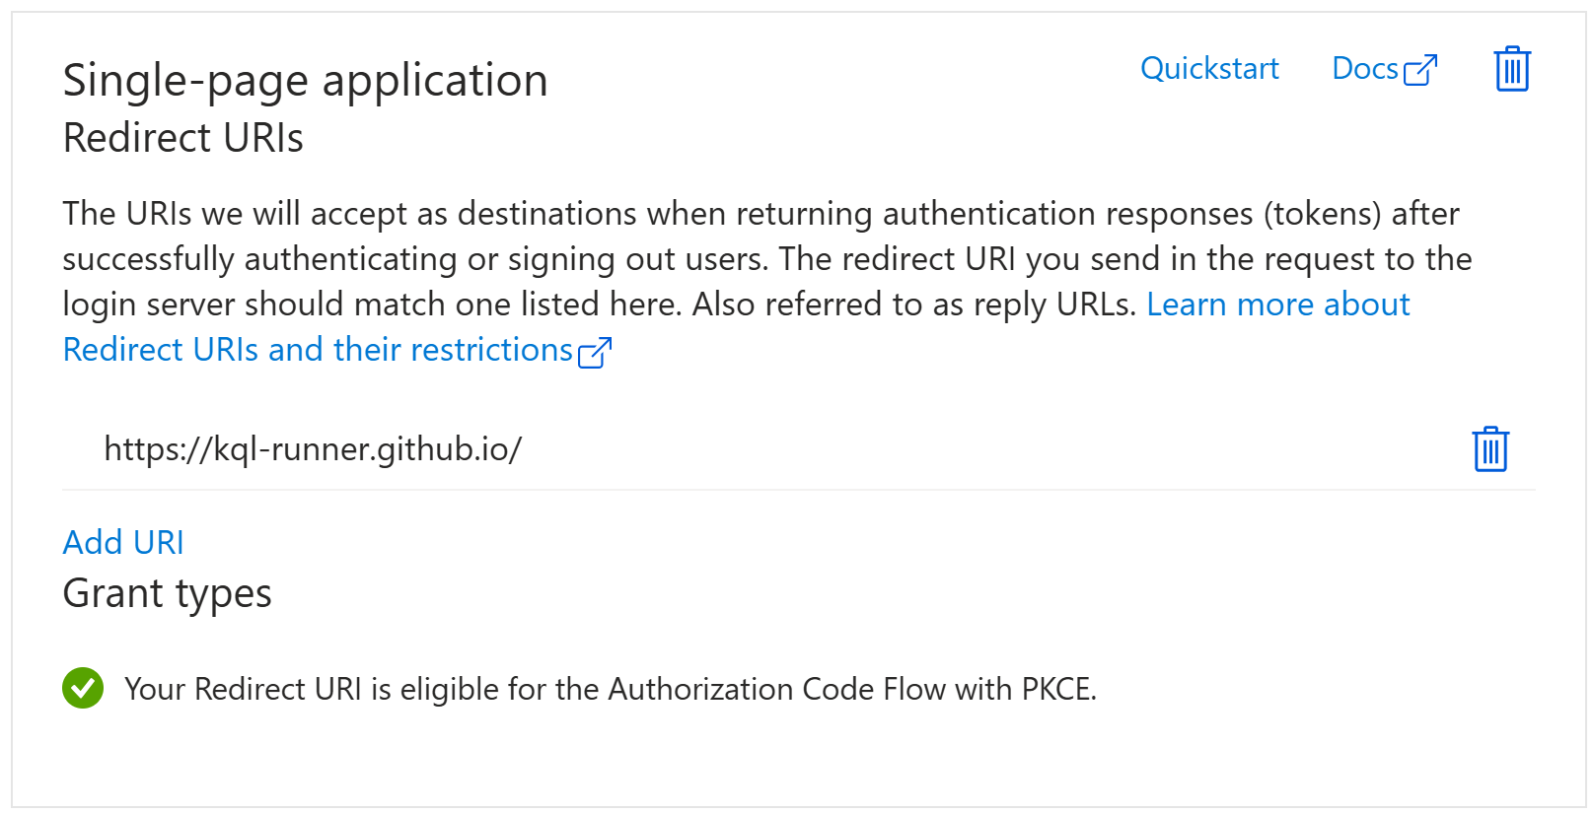
EntraID Registered App
Authentication

Slide 12
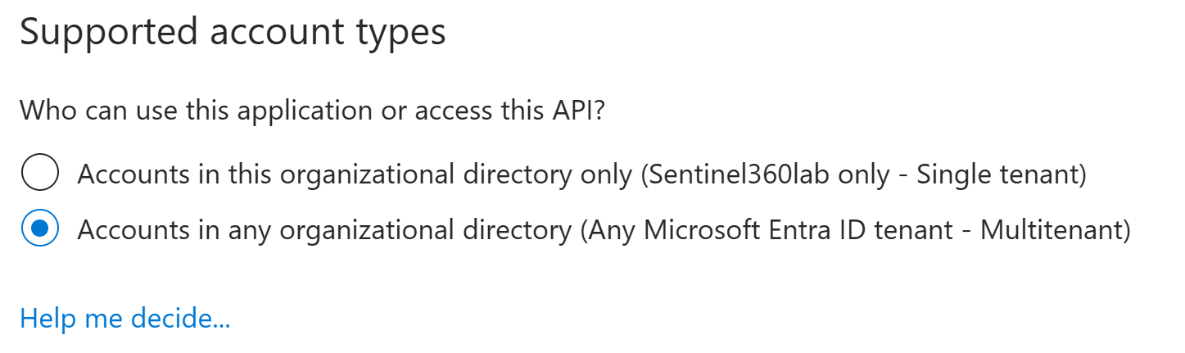
EntraID Registered App
Authentication

Slide 13

Thank you for sipping some KQL Coffee with me today

